Slide 1

SKIN CANCER DETECTION USING TENSORFLOW
SRM INSTITUTE OF SCIENCE AND TECHNOLOGY
FACULTY OF ENGINEERING AND TECHNOLOGY
DEPARTMENT OF NETWORKING AND COMMUNICATIONS
18CSP107L - MINOR PROJECT
Paidipati Lakshman Sai (RA2011027010202)
Paidipati Charan Ram (RA2011027010186)
Guide name: Dr. SV. Shri Bharathi
Designation: Assistant Professor

Slide 2
Table of contents
Abstract
Objectives
Literature Review
Design Diagrams
Algorithms Used
Dataset
Proposed Research
Implementation
Result
References

Slide 3
Abstract
Skin cancer is a prevalent and potentially lethal disease. Early detection plays a crucial role in effective treatment.
This project leverages deep learning and TensorFlow to develop a skin disease classifier capable of distinguishing between benign and malignant skin conditions.
The innovative approach utilizes neural networks to analyze photographic images and classify them as nevus, seborrheic keratosis (benign), or melanoma (malignant).
The project aims to contribute to early cancer diagnosis, thereby improving patient outcomes.
The results demonstrate promising accuracy in classifying skin diseases, laying the groundwork for further advancements in computer-aided diagnosis.

Slide 4
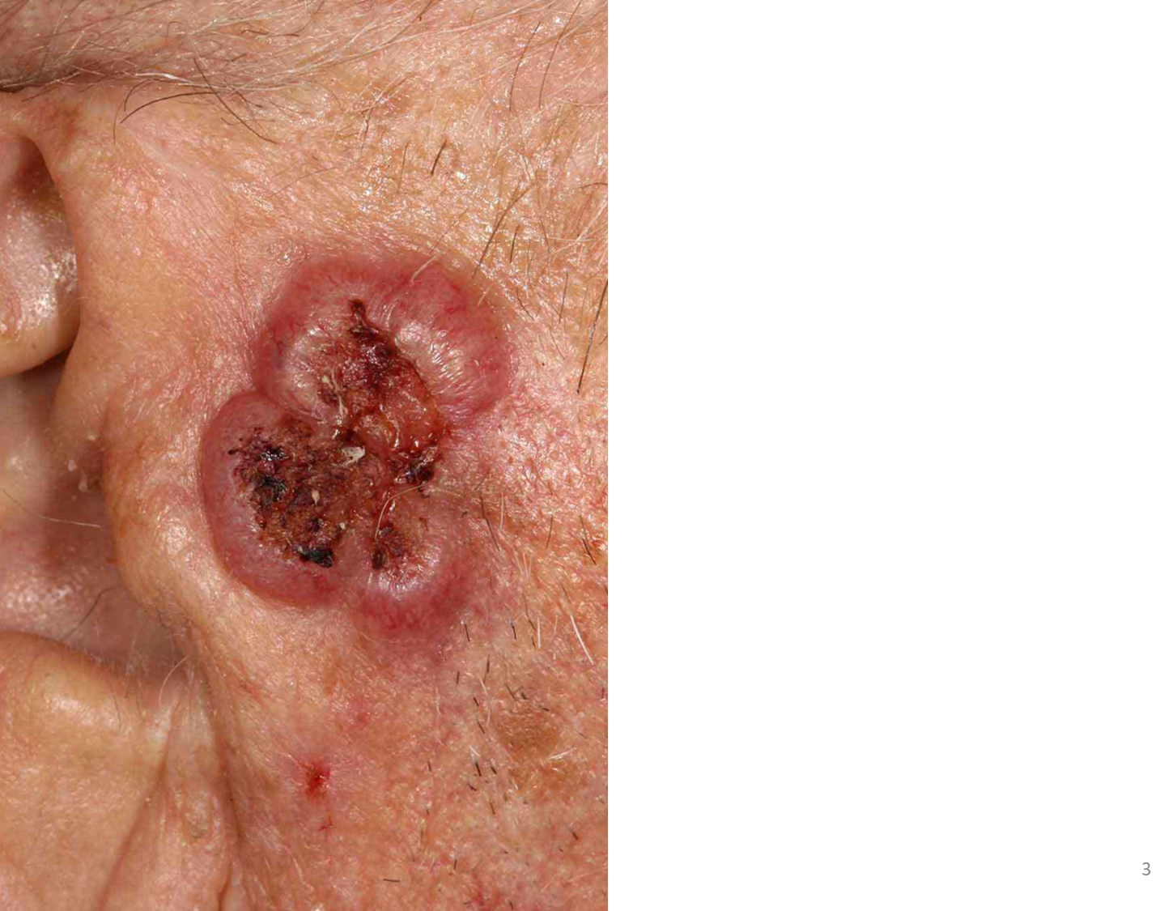
Introduction
Skin cancer is an abnormal growth of skin cells, it is one of the most common cancers and unfortunately, it can become deadly. The good news though is when caught early, your dermatologist can treat it and eliminate it entirely.

Slide 5
Objectives
Develop a Skin Disease Classifier:Design and implement a robust skin disease classifier using Support Vector Machines (SVM) and digital image processing techniques.
Distinguish Between Benign and Malignant Skin Diseases:Train the classifier to accurately distinguish between benign skin diseases (nevus and seborrheic keratosis) and malignant skin diseases (melanoma).
Improve Accuracy and Efficiency of Diagnosis:Enhance the accuracy and efficiency of skin cancer diagnosis by leveraging machine learning techniques, reducing misdiagnoses, and streamlining the diagnostic process.
Explore the Use of SVM in Skin Cancer Detection:Investigate and demonstrate the effectiveness of Support Vector Machines as a classification tool for skin cancer detection, providing insights into its application in medical image analysis.
Contribute to Early Detection Practices:Contribute to the field of early skin cancer detection by proposing and implementing a solution that aids in the identification of skin diseases at an early stage.

Slide 6
Literature Review
"Deep Learning Approaches for Skin Cancer Classification"
Authors: Esteva, A., Kuprel, B., Novoa, R. A., et al.
This foundational study explores the application of deep learning, particularly convolutional neural networks (CNNs), in the classification of skin cancer. The research evaluates the potential of these advanced neural networks in achieving accuracy comparable to dermatologists. By training CNNs on a large dataset of skin images, the study demonstrates the model's ability to distinguish between benign and malignant lesions, setting the stage for subsequent research in AI-driven dermatology.

Slide 7
"Dermatologist-level Classification of Skin Cancer with Deep Neural Networks"
Authors: Codella, N., Gutman, D., Celebi, M. E., et al.
This collaborative effort investigates the partnership between dermatologists and deep neural networks for skin cancer classification. The study evaluates various neural network architectures, including Inception and ResNet, to achieve dermatologist-level accuracy in identifying melanoma. By comparing the performance of AI models with human experts, the research emphasizes the potential for combining the strengths of both to enhance diagnostic capabilities.

Slide 8
"A Review on the Applications of Deep Learning in Skin Cancer Classification"
Authors: Haenssle, H. A., Fink, C., Schneiderbauer, R., et al.
This comprehensive review offers a thorough examination of the applications of deep learning in skin cancer classification. It traces the evolution of techniques, from traditional machine learning approaches to the emergence of deep neural networks. The review discusses the challenges in using AI for dermatological diagnosis, such as the need for large annotated datasets and the interpretability of deep learning models.

Slide 9
Skin Cancer Classification Using Convolutional Neural Networks: Systematic Review"
Authors: Fadzil, A. F. M., Lee, K. Y., Ramli, R., et al.
This systematic review synthesizes findings from multiple studies related to the application of convolutional neural networks (CNNs) in skin cancer classification. It analyzes trends, challenges, and areas for improvement in automated skin cancer diagnosis. The review emphasizes the significance of CNNs in achieving high accuracy and explores the potential for transfer learning to address challenges related to limited datasets.

Slide 10
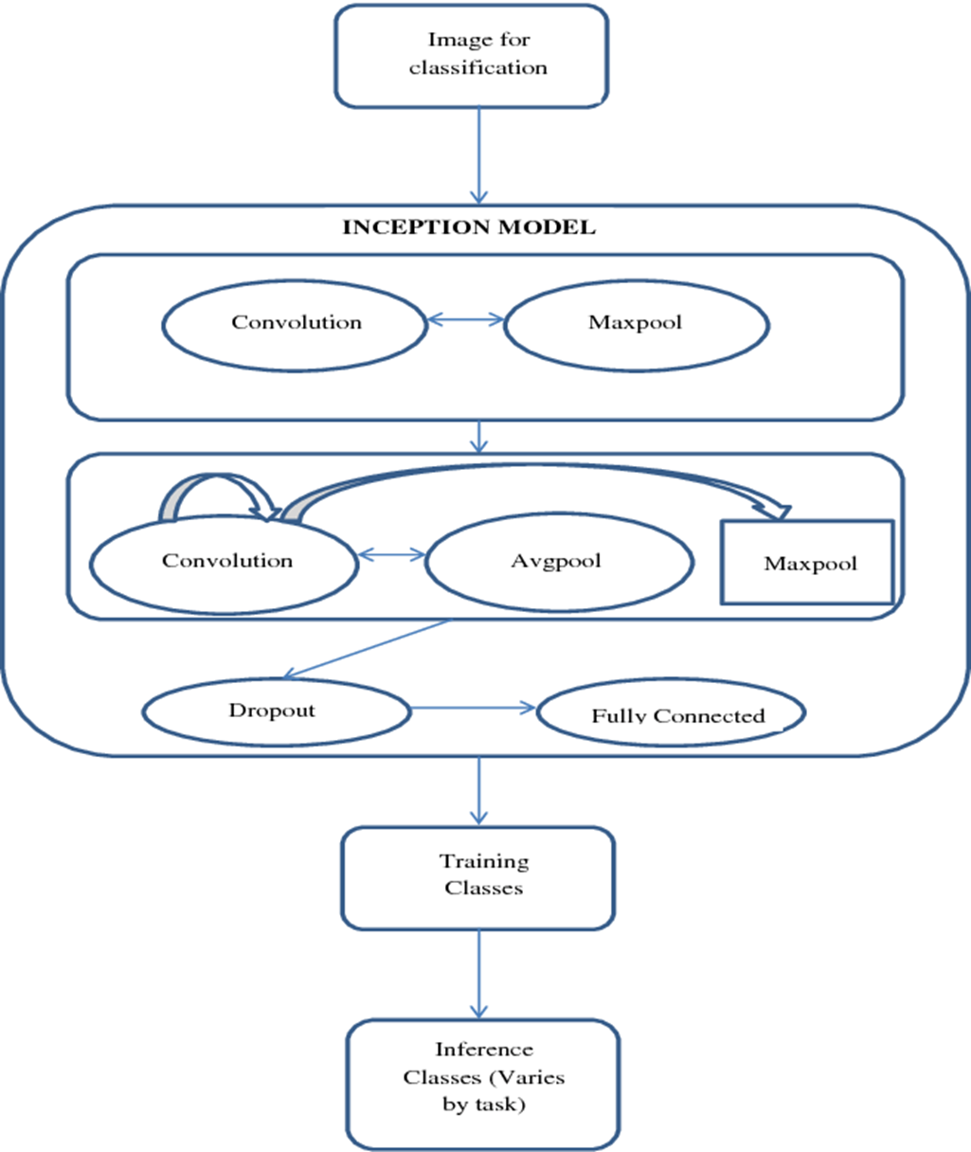
Proposed System Architecture Diagram

Slide 11
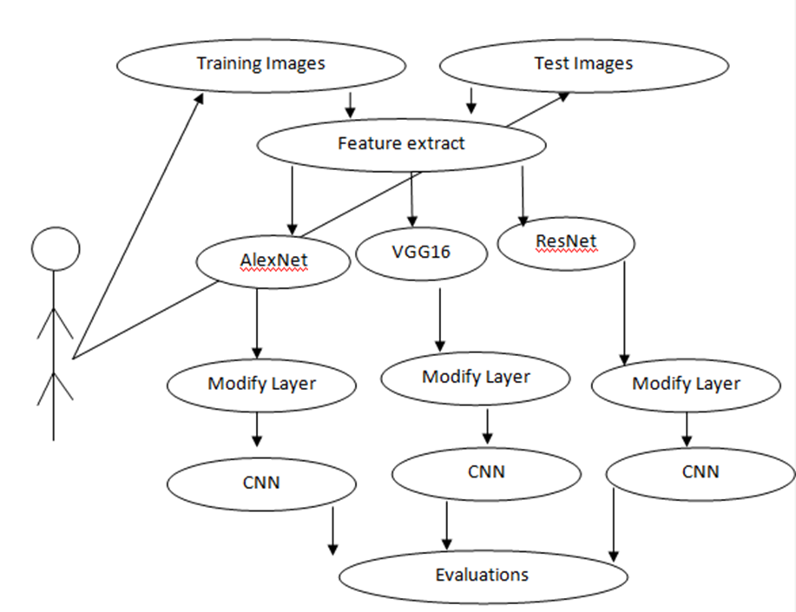
USE CASE DIAGRAM

Slide 12
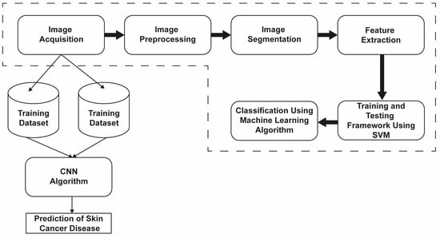
BLOCK DIAGRAM

Slide 13
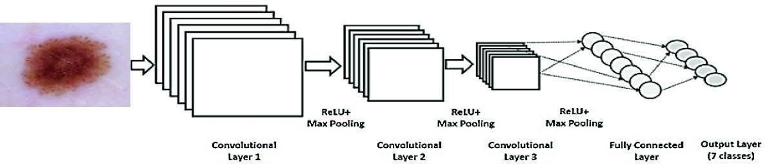
Algorithms Used
Convolutional Neural Networks (CNNs):
CNNs are a fundamental deep learning architecture for image classification tasks. They excel at capturing hierarchical features in images, making them well-suited for tasks like distinguishing between different types of skin diseases based on photographic images.

Slide 14
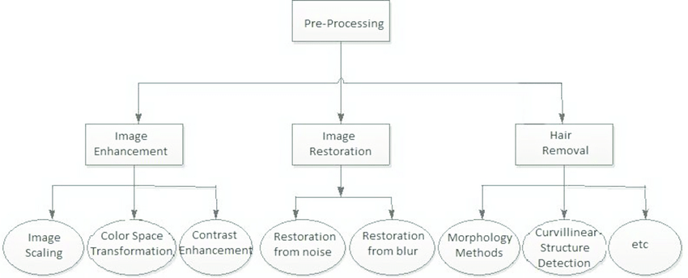
Image Preprocessing Algorithms:
While not explicitly mentioned, the process of preparing photographic images for training likely involves various image preprocessing algorithms. These may include resizing, normalization, and augmentation techniques to ensure that the input data is optimized for the neural network.

Slide 15
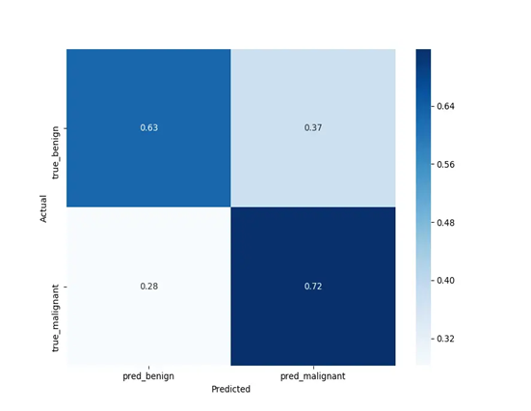
Model Evaluation Metrics:
Algorithms for model evaluation metrics, such as precision, recall, F1 score, and confusion matrix calculations, are crucial for assessing the performance of the trained model on both training and validation datasets

Slide 16
Dataset
The ISIC (International Skin Imaging Collaboration) dataset is a widely used and comprehensive collection of dermatoscopic images for research and development in the field of dermatology, particularly in the context of skin cancer detection. Here are more details about the ISIC dataset:
ISIC Archive:
Link: ISIC Archive
Key Features:
Diversity of Lesions: The ISIC dataset encompasses a diverse range of skin lesions, including both benign and malignant cases. This diversity is crucial for training machine learning models to recognize various skin conditions accurately.

Slide 17
Annotations and Ground Truth: Many images in the ISIC dataset come with expert annotations and ground truth labels. These annotations provide information about the type of skin lesion (e.g., nevus, melanoma) and serve as valuable training data for supervised machine learning algorithms.
High-Quality Dermatoscopic Images: The dataset includes high-quality dermatoscopic images, which are images taken using a dermatoscope—a specialized tool that allows for the examination of skin lesions with increased magnification and illumination.
Large Scale: With a large number of images, the ISIC dataset provides a significant amount of data for both training and testing machine learning models. This large-scale nature helps in developing robust models that can generalize well to different types of skin lesions.

Slide 18
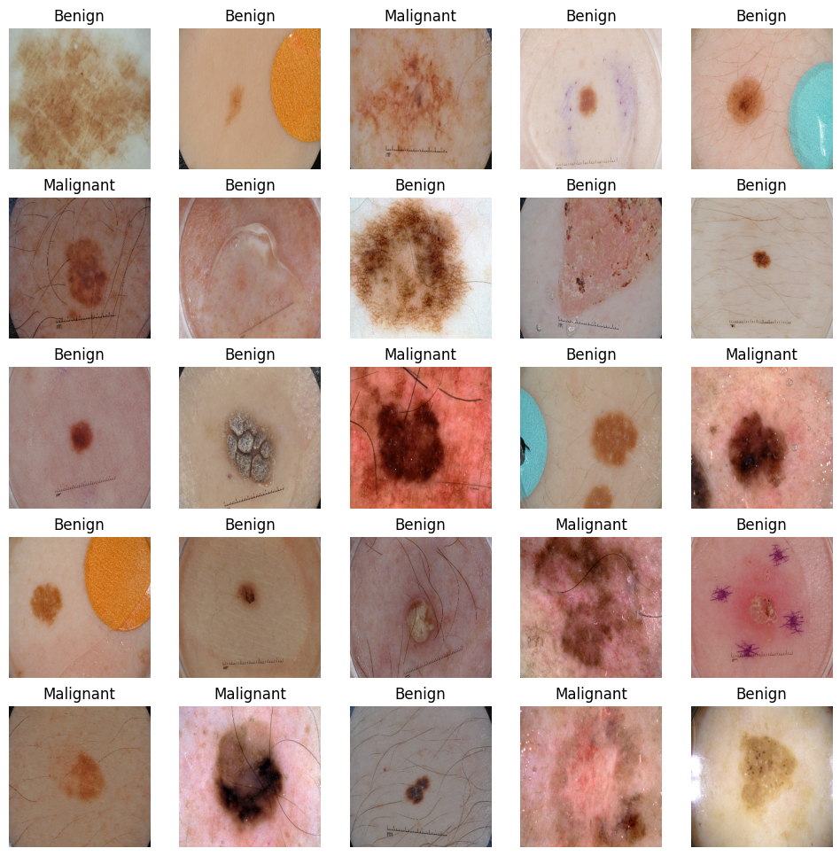

Slide 19
PROPOSED RESEARCH
Proposed model deals with the Skin cancer detection and stage prediction that provides the relevant information for the patients, so that the appropriate treatment can be taken
Proposed system employs Convolutional Neural Network which provides a major advantage of reproducing the expected outcome based on the weight factors and activation function.
This eliminates the cost that is spent on expensive treatment.
The proposed system was tested for a ISIC (International Skin Imaging Collaboration) dataset of image dimensions 620*250 pixels. System mainly concentrated on the results of the skin characters.

Slide 20
Proposed research involves the development and implementation of an innovative skin disease classification system using deep learning techniques, specifically focusing on distinguishing between benign and malignant skin diseases.
The research aims to contribute to the field of medical image analysis and skin cancer detection by leveraging state-of-the-art technologies.
Utilize Convolutional Neural Networks (CNNs) for feature extraction and hierarchical representation of skin disease images.

Slide 21
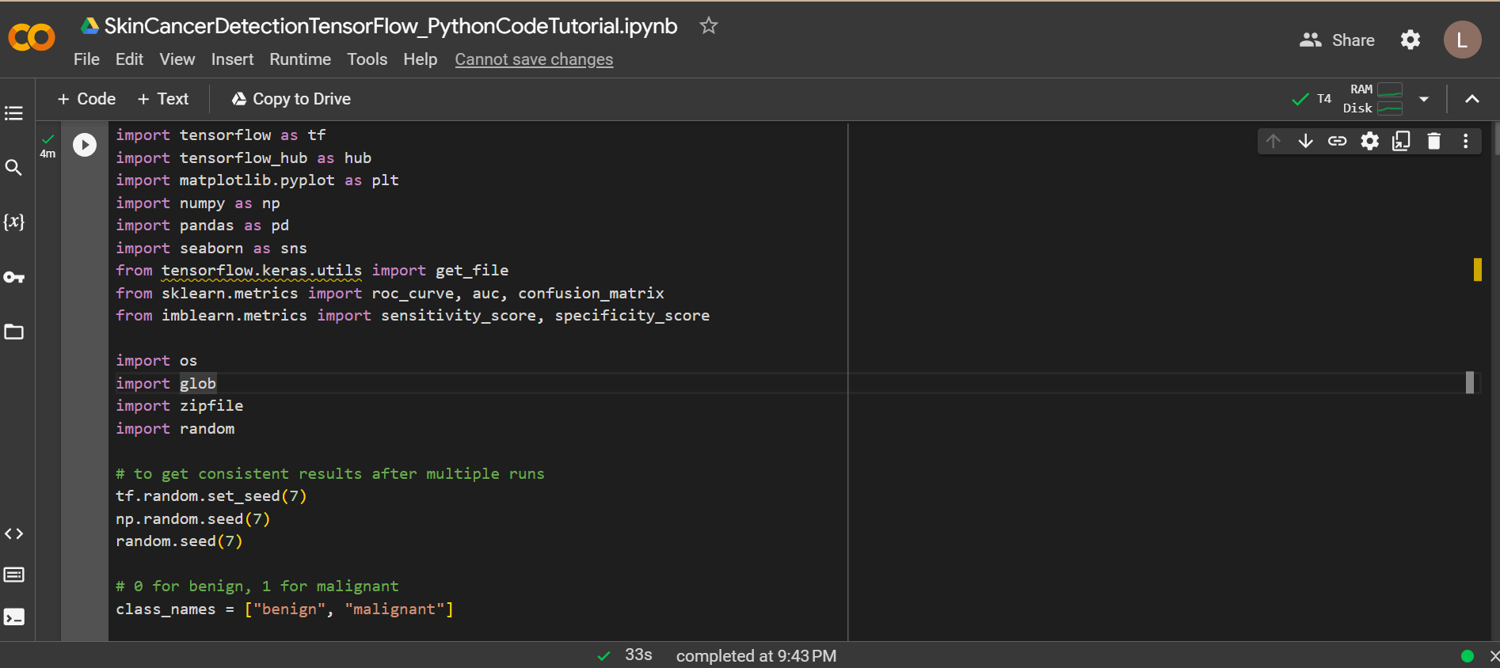
IMPLEMENTATION

Slide 22
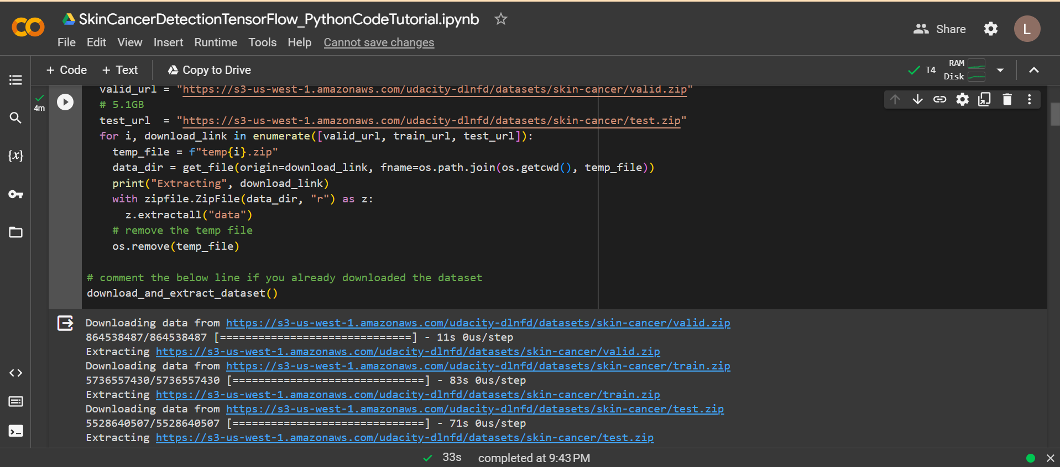

Slide 23
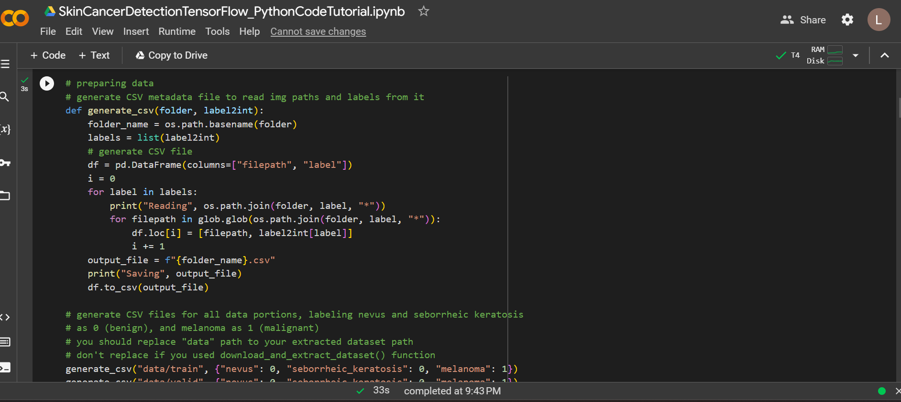

Slide 24
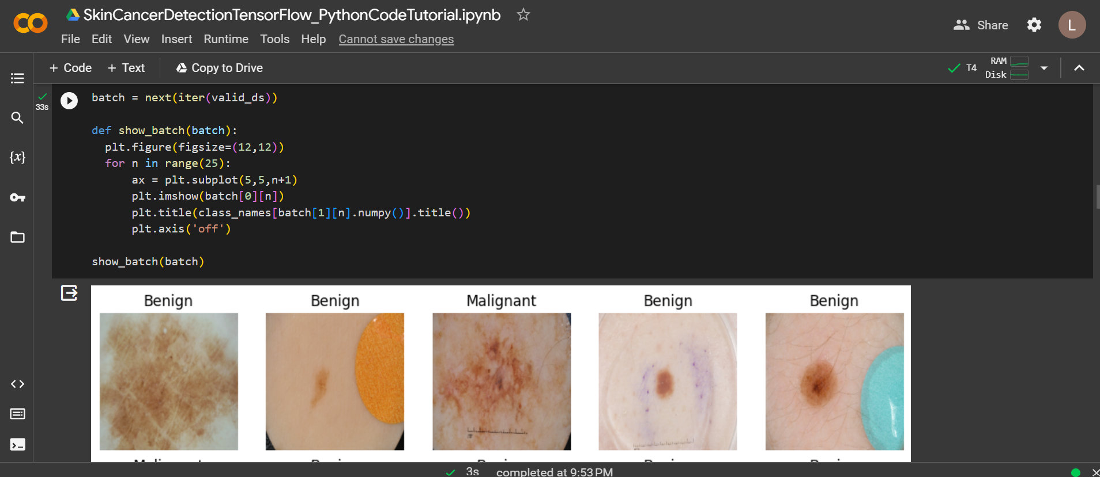

Slide 25
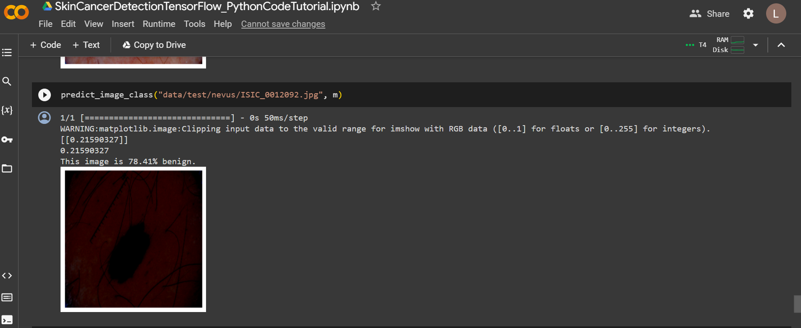

Slide 26
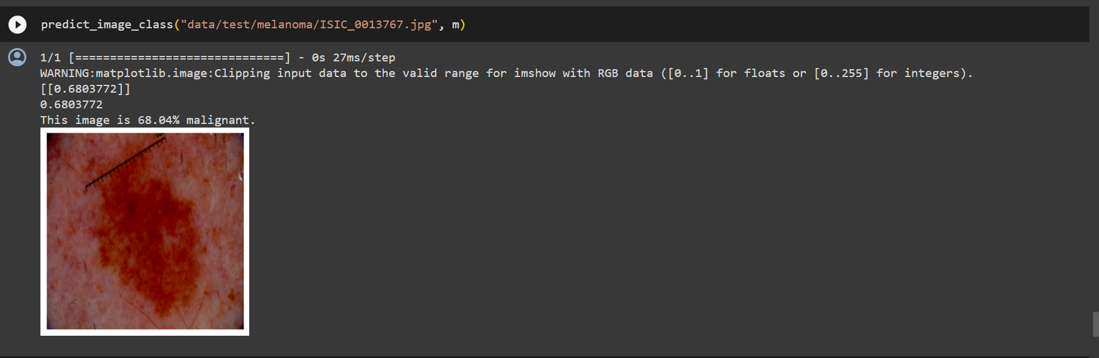
INITIAL RESULT
The initial results reveal a promising foundation for the skin cancer detection model.
Ongoing research and refinement efforts are expected to contribute significantly to the field of medical image analysis.

Slide 27
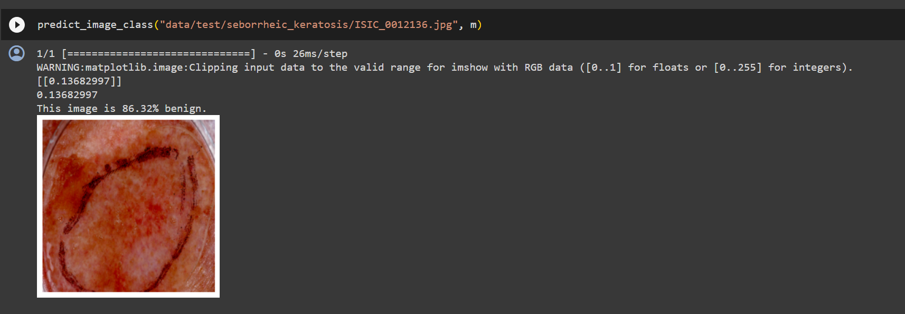

Slide 28
References
Subramanian, R.R.; Dintakurthi, A.; Kumar, S.; Reddy, K.; Amara, S.; Chowdary, A. Skin Cancer Classification Using Convolutional Neural Networks. In Proceedings of the 2021 11th International Conference on Cloud Computing, Data Science & Engineering (Confluence), Noida, India, 28–29 January 2021. [Google Scholar]
Harsha, P.; Sahruthi, G.; Vaishnavi, A.; Varshini, P. Spotting Skin Cancer Using CNN. Int. J. Eng. Tech. 2022, 8, 47–51. [Google Scholar]
Dubai, P.; Bhatt, S.; Joglekar, C.; Patii, S. Skin Cancer Detection and Classification. In Proceedings of the 2017 6th International Conference on Electrical Engineering and Informatics (ICEEI), Langkawi, Malaysia, 25–27 November 2017; pp. 1–6. [Google Scholar] [CrossRef]

Slide 29
Jana, E.; Subban, R.; Saraswathi, S. Research on Skin Cancer Cell Detection Using Image Processing. In Proceedings of the 2017 IEEE International Conference on Computational Intelligence and Computing Research (ICCIC), Coimbatore, India, 14–16 December 2017. [Google Scholar]
Dildar, M.; Akram, S.; Irfan, M.; Khan, H.U.; Ramzan, M.; Mahmood, A.R.; Alsaiari, S.A.; Saeed, A.H.M.; Alraddadi, M.O.; Mahnashi, M.H. Skin Cancer Detection: A Review Using Deep Learning Techniques. Int. J. Environ. Res. Public Health 2021, 18, 5479. [Google Scholar] [CrossRef] [PubMed]
Hosny, K.; Kassem, M.; Fouad, M. Skin Cancer Classification Using Deep Learning and Transfer Learning. In Proceedings of the 2018 9th Cairo International Biomedical Engineering Conference (CIBEC), Cairo, Egypt, 20–22 December 2018. [Google Scholar]

Slide 30
THANK YOU

